Slide 1



Citywide Connect: Spring 2017 Locality Hubs Evaluation
Presentation to the Partnership Board
23rd May 2017

Slide 2
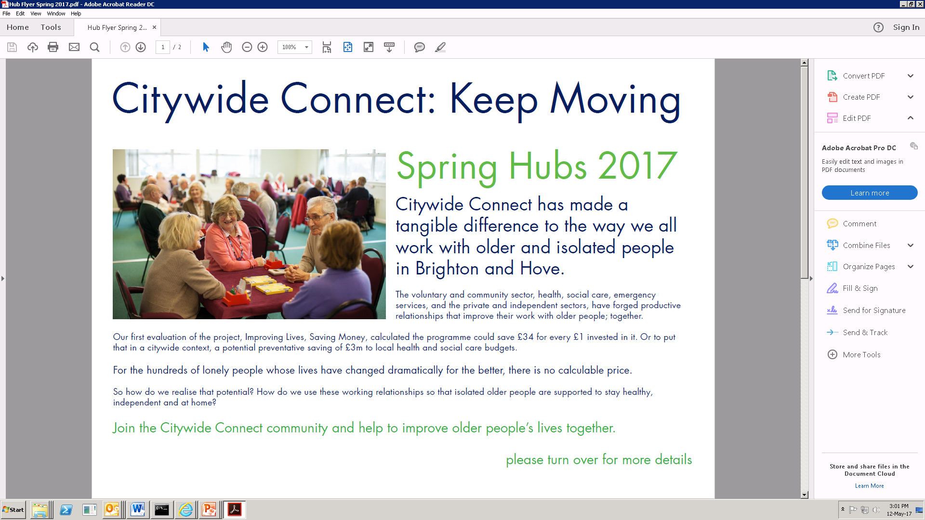
Engagement

Slide 3
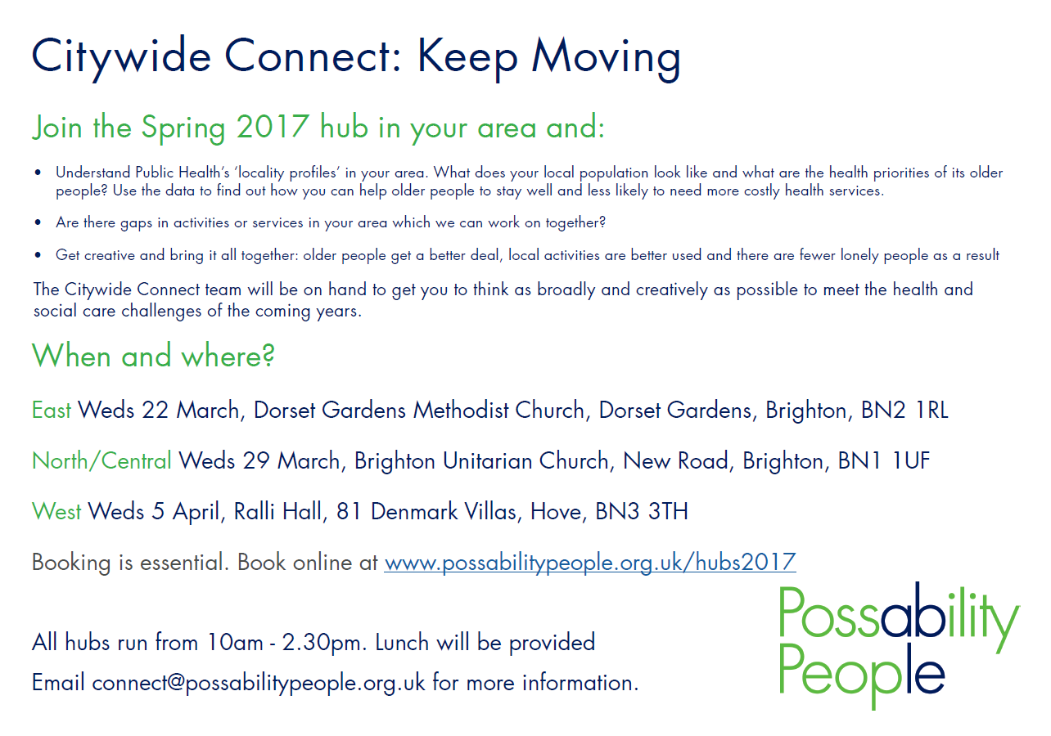

Slide 4
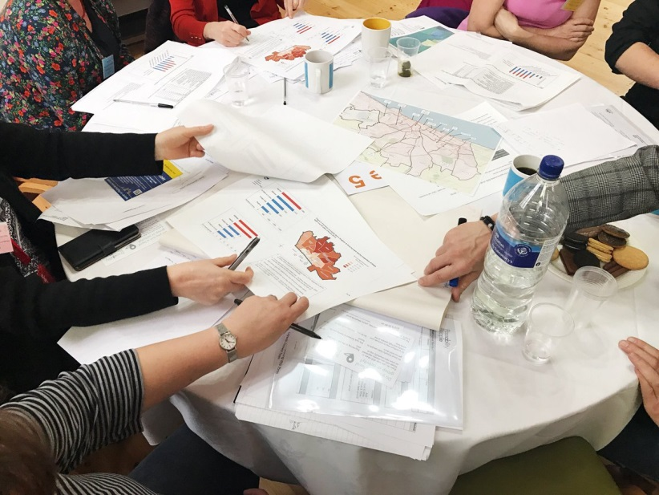
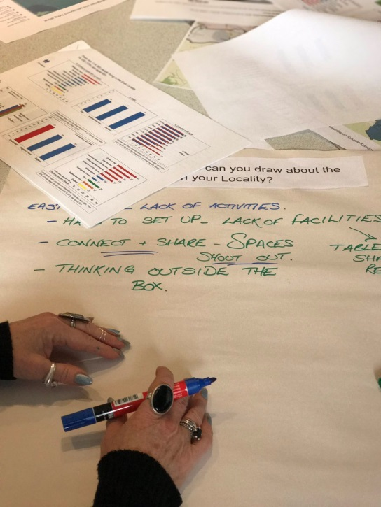
Part 1:
Profile and characteristics of older people residing in each of the Locality areas
Using known risk factors
Identifying assets/solutions, gaps, challenges, blockages

Slide 5
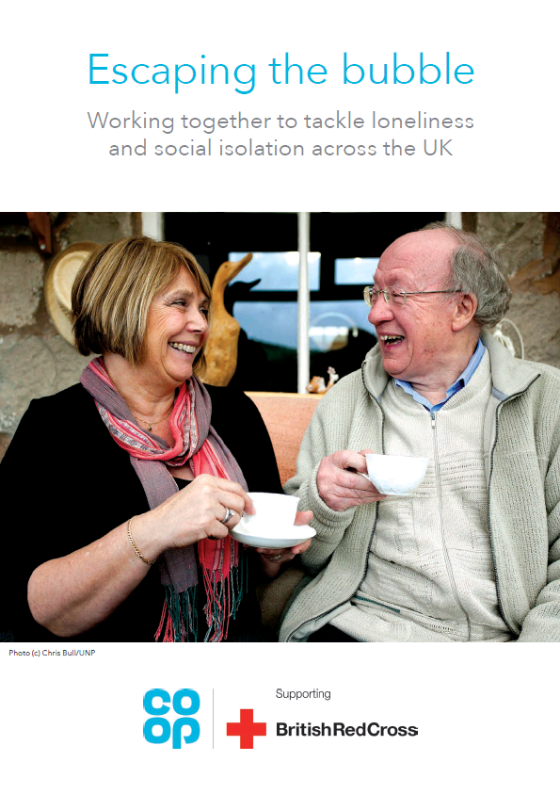
Part 2
Preventing vulnerability
  Raising awareness of the key transitions/risk points
  What exists to support people experiencing these
  Where are the gaps?
  Areas for future focus

Slide 6
Spring 2017 Locality Hubs: Attendance
 | East | North/Central | West
Booking | 48 | 41 | 54
Attendance | 46 | 32 | 48
Ratio | 96% | 74% | 89%
Average = 86%
Attendance: Total | 128

Slide 7
Attendance by Sector

Slide 8
Engagement
1%
3%
18%
34%
8%
15%
20%

Slide 9
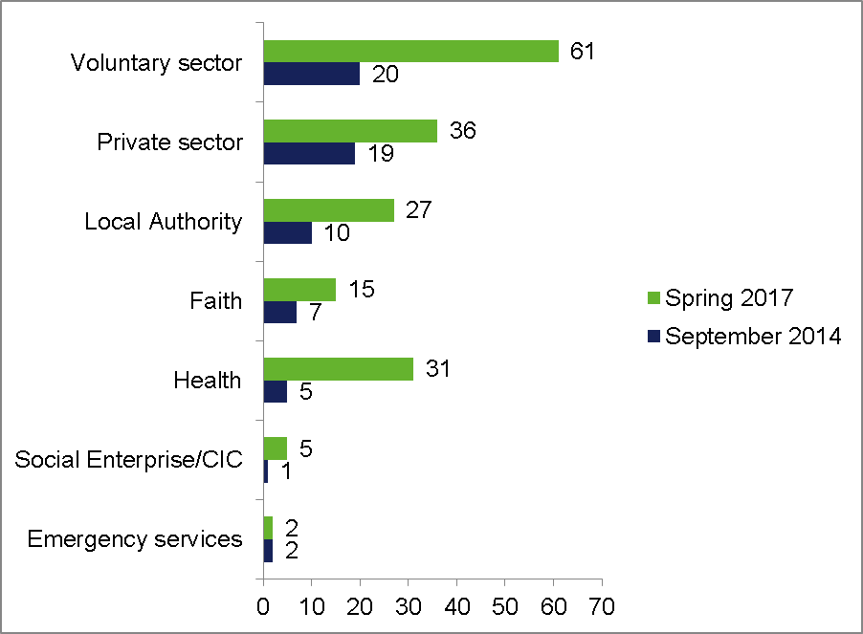
Engagement: growth

Slide 10
Operational effectiveness

Slide 11
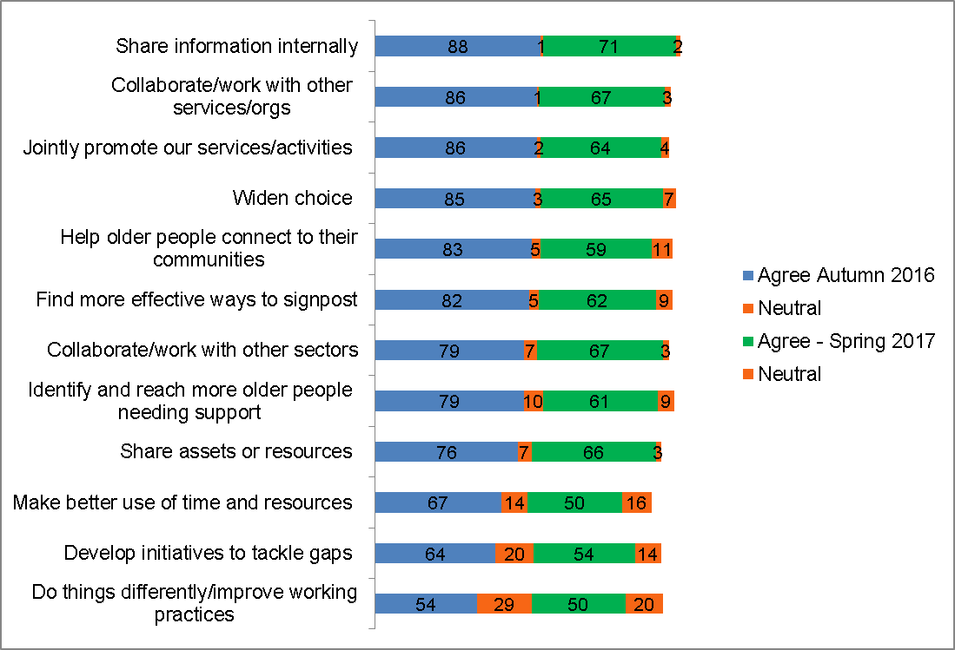
Post event intentions

Slide 12
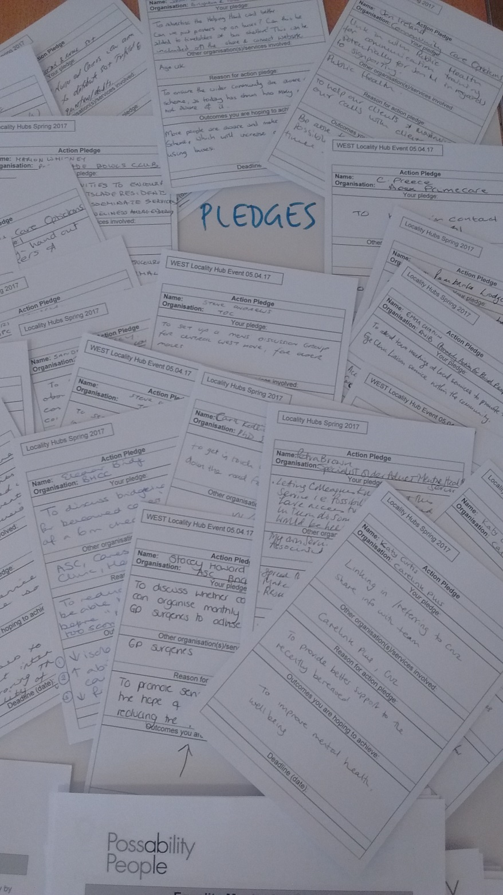
Pledging for action

Slide 13
 |  | Sector Pledged With
Lead Pledge Partner | Number of pledges | CVS | Local authority | Private | Emergency Services | Faith | Health | CIC/Social Enterprise | Multiple
CVS | 29 | 21 | 1 | 1 | 0 | 1 | 3 |  | 2
Local Authority | 18 | 9 | 5 |  |  | 1 | 1 |  | 2
Private | 11 | 6 | 2 | 1 |  |  |  |  | 2
Health | 7 | 4 | 1 | 1 |  |  |  |  | 1
Faith | 4 | 2 |  |  |  | 2
Emergency Services | 1 |  |  | 1
CIC | 1 | 1
Total pledges | 72

Slide 14
Pledge Outcomes

Slide 15
Pledge examples by outcome
 | Lead pledge organisation/ sector | Organisation/ sector pledging with | Pledge
Widen choice/more effective signposting | Sussex Community NHS, Health | Citywide Connect – CVS | To feed back to my team of nurses, physios and OTs in the Hove area about the event. Contact various groups to come and talk at Therapy Assistants training which I organise.
 | Home Instead Senior Care, Private | National Osteoporosis Society, Red Cross, Library Service, Age UK – CVS, Local Authority | Invite guest speakers to our caregiver team meetings to encourage pro-active sign-posting - improving overall wellbeing and reducing isolation for our clients.

Slide 16
 | Lead pledge organisation/ sector | Organisation/ sector pledging with | Pledge
Develop closer links with other orgs/services/ sectors | One Church, Faith | Lifelines, Community Transport, RNIB - CVS | Meet and discuss opportunities for joint working to organise outings for people living in sheltered accommodation.
Identify and reach more people needing support | The Carers Centre, CVS | The Carers Team, BHCC – Local Authority | Improve joint working and communication. Exchange ideas for ways to identify isolated carers in Brighton & Hove.
Joint promotion/ share assets or resources | East Sussex Fire & Rescue Services, Emergency Services | Brighton & Hove Buses – Private | Work with Brighton & Hove Buses to publicise home safety visits on buses and work together on Christmas road safety campaign.

Slide 17
 | Lead pledge organisation/ sector | Organisation/ sector pledging with | Pledge
Develop new initiative/ activity or service | Pembroke Lodge Home Care, Private | Social Workers - Local Authority | There is a need for vulnerable people in the community to be able to take showers/baths with supports. Investigate how we can help.
 | British Red Cross, CVS | Funeral Directors – Private | To create a piece of work on funeral directors and support they can offer to the local community when services such as Cruse are running with a long waiting list. Aim is to develop an easily accessible info point for organisations
Workforce learning/share information internally | Complete Community Care, Private | Public Health – Local Authority | Link in with Public Health for MECC training to maximise our calls with clients re signposting. Being as helpful as possible in a short amount of time

Slide 18
Action Planning Groups:
Case Studies

Slide 19
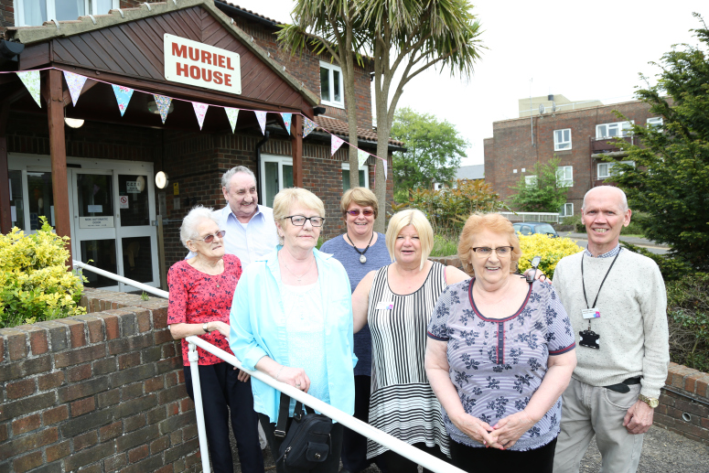
THE LET’S COOK CLUB:
Wednesday 3 May 2017 At Muriel House
Menu
Homemade Cottage Pie and Spring Cabbage
Apple Crumble and Ice Cream @ £3.00 pp
Attendees:
Muriel House – 8 , Sanders House - 10
Feedback:
Very positive from all diners from attending from both schemes. One tenant at Sanders House was overwhelmed and very happy with his meal. He was given a plate of leftovers for his dinner the next night but said he could not wait as it was so lovely and ate it the same day
Outcomes:
One of the tenants attending from Sanders House is now linked in with 2 other residents at this scheme who will cook extra portions so he gets a home cooked meal now and again. He has also been referred to the Casserole Club. Another male resident was encouraged to return to the Tuesday Lunch Club at Hove Methodist Church, using the transport provided.
A new male resident at Muriel house who had yet to venture out of his flat since moving in, attended the lunch club and enjoyed the food and the social aspect of it so much, he came down the next day for the card bingo activity and loved it. He said he will be attending the activities regularly from now on, rather than just sitting in his flat.

Slide 20

Sharing information with the Citywide Connect network eg:
Digital inclusion training
Publicity materials - local gadget drop-ins and local skills sessions
Resources eg useful apps and links to new Social Care Help Online
Development of new activities:
Promoting opportunities to learn digital skills in community newsletters e.g. Home & Company, Time to Talk Befriending, St Mary’s (Connect & Share)
Digital inclusion sessions for dementia support groups.
Provision of digital inclusion information to those involved in the Food Poverty Action Plan.
Inclusion of information on My Life and It’s Local Actually in digital inclusion briefings given to Council and NHS staff

Slide 21

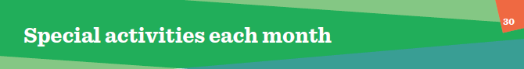

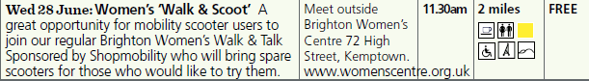
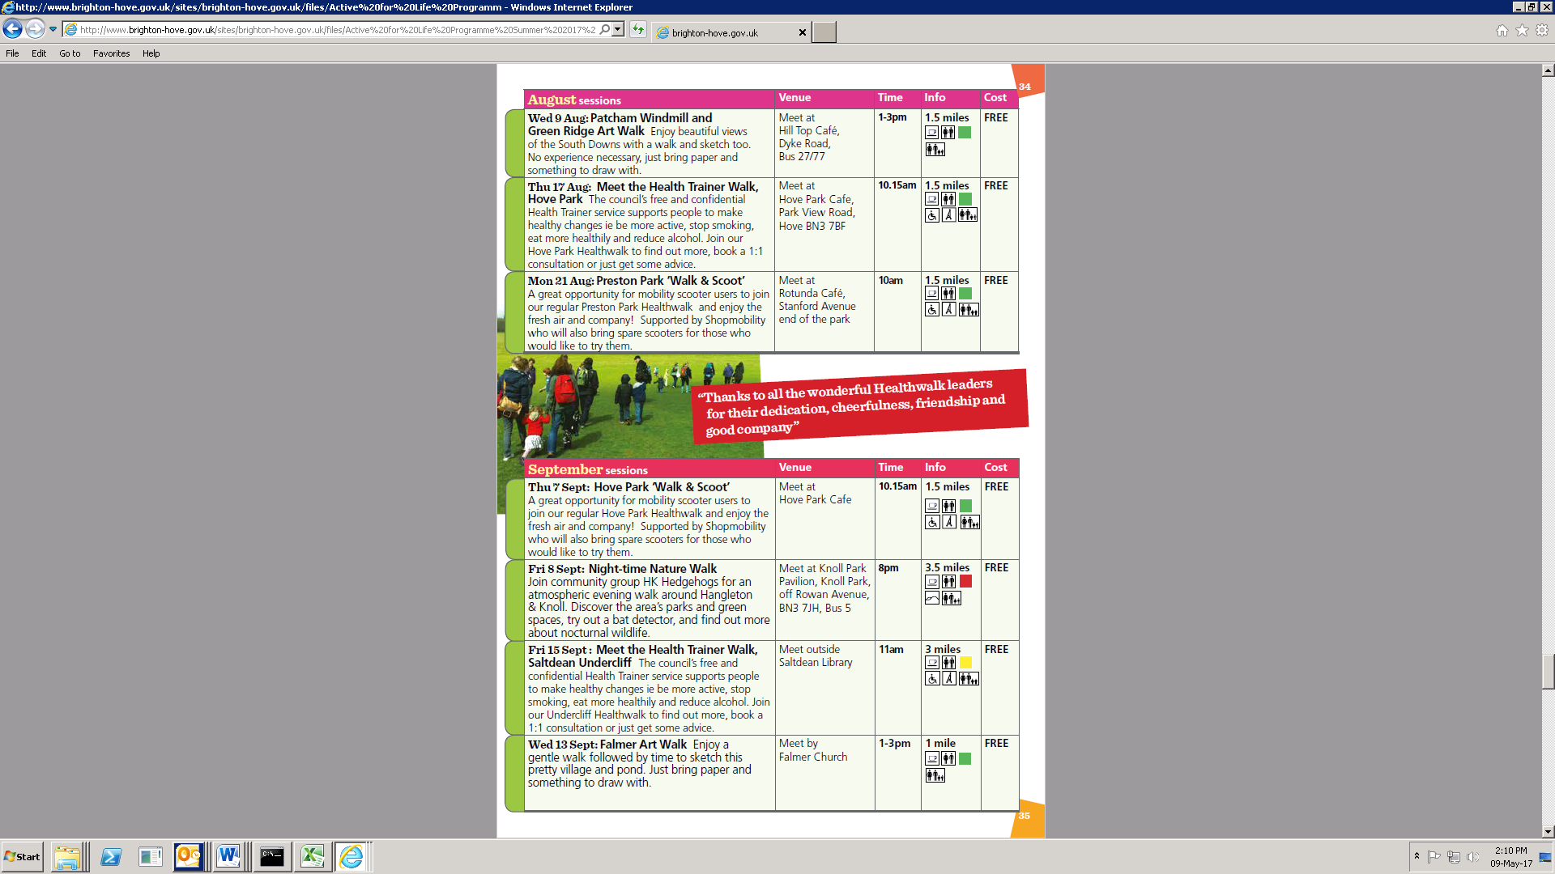

Healthwalks and Possability People’s Shopmobility team are working together to promote and encourage attendance of Healthwalks for mobility scooter users

Slide 22
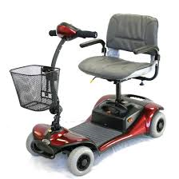
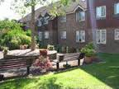
Possability People’s Shopmobility service are working in partnership with seniors housing to raise awareness and encourage use of Shopmobility
Outcomes:
People able to visit local shops and further afield independently
Volunteering opportunities for peer trainers
Brings together residents – greater social interaction
Raises awareness of scheme
Scheme can use a springboard for developing ‘local community offer’

Slide 23

Part 1:
Locality data
observations assets/
solutions, gaps,
challenges and blockages

Slide 24
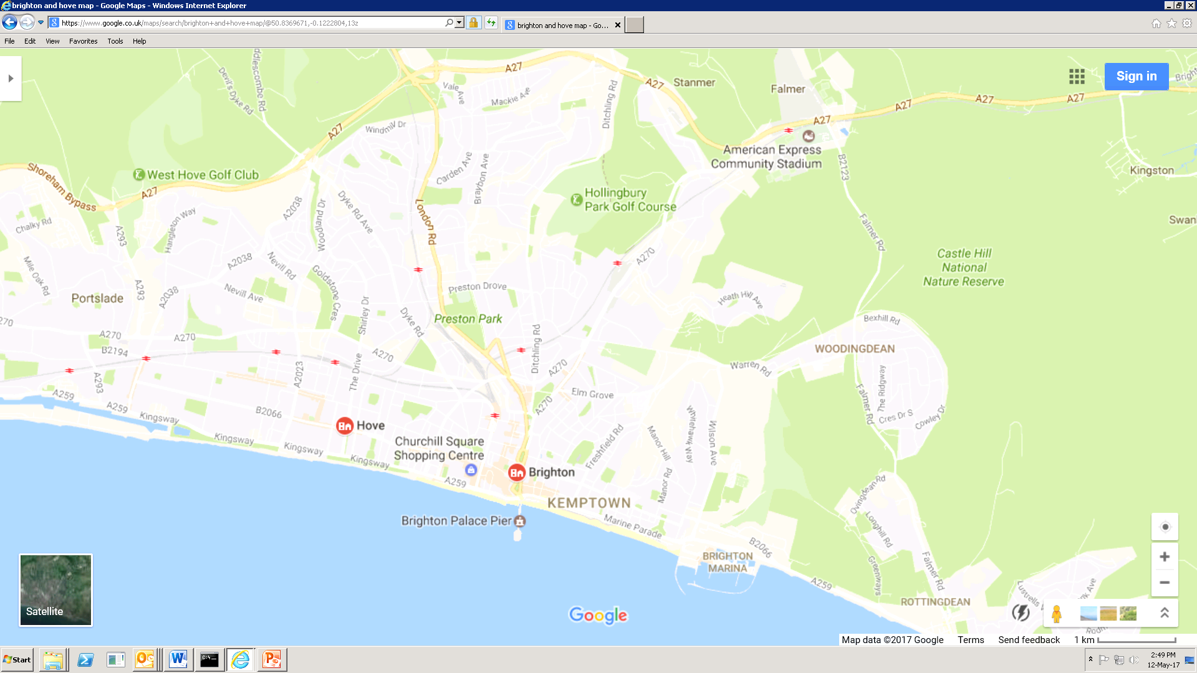

North/Central
West
East
Patcham
Hangleton
& Knoll
M/Coomb
& Bevendean
Hove Park
Woodingdean
Regency/
St Peter’s
& N Laine

Slide 25

East Locality
Challenges
Assets
Students replacing families = lack of community / fear / lack of services – “feeling like a stranger in your own community”
Hard to set up activities: lack of facilities
High material deprivation = poor social connectedness, lower life expectancy,
More likely to have a disability/long-term health condition
Lack of NHS services eg walk in dentists
Geographical barriers reinforce social isolation “low percentage of BME but they could be more isolated than those living in other parts of the city”
Highest number of carers compared to west and North/Central
The Deans = fastest growing Neighbourhood Watch Networks
BHCC Seniors Housing
Woodingdean – Java Community Café, Strong sense of community, active Councillor
Building based assets
LifeLines developing activities in the Deans
Lots going on in Rottingdean – LifeLines scoping exercise

Slide 26
North Central Locality
Assets
Challenges
“Thought Patcham was mainly families – surprised at numbers of older people living there.” Most people travelling into town for activities “Less of a community feeling – sprawling, no local shops..not much going on”
High % of carers
Regency / St Peters & North Laine: surprised at older population rates and high % of poverty. “High density living: urban loneliness”
Home ownership (affluence doesn’t protect you from loneliness) / property rich, cash poor
Distance to the centre / hilly terrain
Lack of community
Brookmead housing scheme - opening up activities for people with dementia
BHCC Seniors Housing
Vibrant community centre in Patcham
Cinema – new Larchwood

Slide 27
West Locality
Challenges
Assets
Hangleton: High % of Arabic speaking residents “older people in want practical support vs befriending – staying independent at home” Difficulties getting there restricts recruitment of care staff
Hove Park: ‘Property rich: cash poor’ / High % of carers / Private payers – limited access to services high rates of loneliness / Families living far away / Not eligible for funeral care
High loneliness in affluent areas. “Wealthier people can be cut off and left alone”
Brunswick & Adelaide: “Surprised so many people isolated here as it’s densley populated with lots of shops and facilities”
“The myth of Hove being an affluent and connected community is untrue according to the data”
Lunch Club Pilot: Sanders & Muriel House
Portslade Bowls Club: “to use the club to disseminate services available to avoid loneliness among elderly” Provide trips out and a social club
Making more use of the Anglers Clubs (Hove Lagoon) as an activity for men
BHCC Seniors Housing

Slide 28
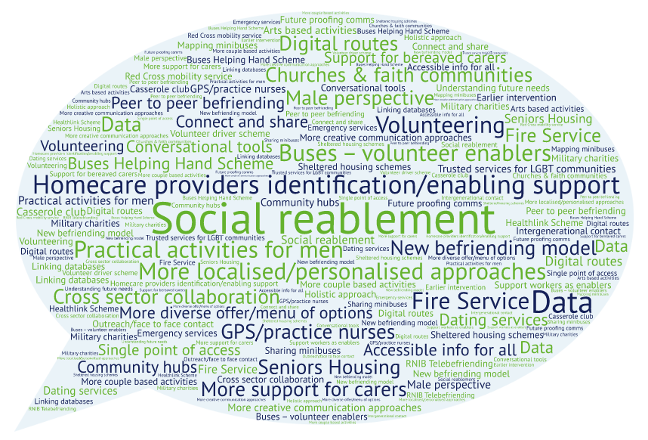
Solutions

Slide 29
Low support:
high need
Men
Carers
People with long-term health conditions
/impairments
Private payers
Blockages
Social/out and about enablement
Transport
Identifying and reaching

Slide 30
Part 2: Preventing vulnerability
“Our research shows that life transitions are key triggers for loneliness. We need to focus on these moments and work together to prevent loneliness from taking hold in the first place”

Slide 31
Key Risks/Transition Points
Although loneliness can affect anyone and has no single cause, the link to loss of identity is common and crucial.
Major life events = moments of particular risk.
Six groups whose identity has been disrupted.
  People with mobility difficulties
  People with health issues
  Recently bereaved
  Recently divorced/separated
  Retirees
  Empty nesters
  73% always or often lonely

Slide 32
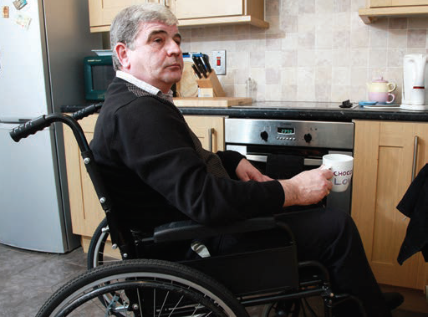

People with mobility difficulties:
“I no longer have the freedom of jumping on and off buses or driving my own car”
30% always or often feel lonely
29% of people with limited access to transport said they always or often feel lonely
People with health issues
“Before I got ill I had a life. There are so many things that I can’t even do”
32% always or often feel lonely

Slide 33

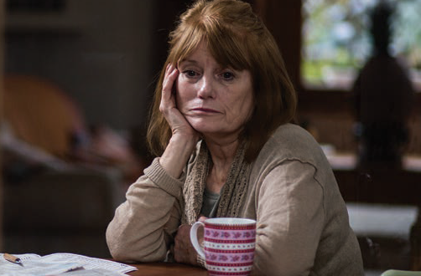

Retirees/people living without children at home
“I didn’t expect routine to be as hard to set as it has been. I thought I’d be surrounded by more people”
46% who are regularly lonely said they wouldn’t know where to turn for help
People recently bereaved
“When I could feel more up to talking or going out, most people had moved on with their own lives”
54% who are regularly lonely said they wouldn’t know where to turn for help
Recently divorced/separated
“I found it really hard being on my own again; you think going to a party and other occasions by yourself is a big thing”
33% always or often feel lonely

Slide 34
What works: no single solution
No one-size-fits-all solution to tackling loneliness
Different people need different kinds of support –
  and these needs can vary, depending on the level of their loneliness
A mix of approaches needed to:
  prevent
  respond
  restore

Slide 35
What works: prevent
Identifying triggers and groups of people at particular risk before their situation becomes chronic
What can you do?
Raise awareness of transition points
Use resources available in libraries
“Whole family approach”
Four pledges related to bereavement support
Identify entry points
What can CWC do?
Extend engagement to include funeral directors/employers
Investigate additional options for bereavement support
More links with informal high street professionals (hairdressers, taxi drivers, etc)
Help with identifying entry points
Identify succession planning opportunities with employers

Slide 36
What works: response
Timely and tailored response to people experiencing lower-levels of loneliness
What can you do?
Offer practical support for the recently bereaved eg cookery classes
Raise awareness of activities such as Healthwalks, arts based activities, gardening groups
Develop activities tailored for specific transition groups
Volunteering programmes
Shared lives scheme/Casserole Club (Empty nesters)
What can CWC do?
Work with activity providers to develop provision for those experiencing life transitions
Encourage the private sector to plug gaps, work with employees at transition points

Slide 37
What works: restore
Rebuilding people’s confidence and sense of connection when they have experienced loneliness over a longer period and their situation is at risk of becoming chronic.
What can you do?
Access conversational tools to help with this – MECC, Citywide Connect’s Living Well : keeping Connected course
Buddying – 12 week programme of support?
Confidence building courses – professionals and clients
Volunteering programmes
What can CWC do?
Review Living Well: Keeping connected course to reflect transitions/risk points

Slide 38
Reframing loneliness: preventing vulnerability
Focus now on preventing vulnerability
Introducing role of life transitions as disruptive moments that increase risk
Enabling earlier intervention and development of preventative support
Building resilience and skills
Reframing participation

